Slide 1
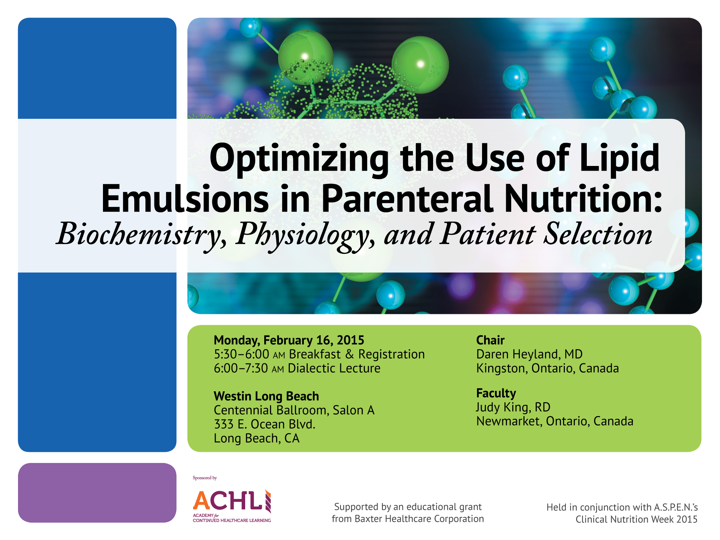

Slide 2
Optimizing the Use of Lipid Emulsions in Parenteral Nutrition
Daren K. Heyland MD
Professor of Medicine
Queen’s University, Kingston, ON Canada

Slide 3
Objectives
What is the ‘optimal’ amount of protein/calories in the ICU patient?
Role of PN in the ICU
Choice of lipid emulsion

Slide 4

RCTs of Early vs. Delayed EN
Review: Early Enteral Nutrition vs. Delayed Nutrient Intake
Comparison: 01 Early EN vs. Delayed Nutrient Intake
Outcome: 02 Infectious Complications
Review: Early Enteral Nutrition vs. Delayed Nutrient Intake
Comparison: 01 Early EN vs. Delayed Nutrient Intake
Outcome: 01 Mortality
Study or Sub-category | Early PN n/N | Delayed n/N | RR (random) 95% CI | Weight % | RR (random) 95% CI | Year
Moore | 1/32 | 2/31 |  | 2.77 | 0.48 (0.05, 5.07) | 1986
Chiarelli | 0/10 | 0/10 |  | Not estimable |  | 1990
Eyer | 2/19 | 2/19 |  | 4.44 | 1.00 (0.16, 6.38) | 1993
Chuntrasakul | 1/21 | 3/17 |  | 3.24 | 0.27 (0.03, 2.37) | 1996
Singh | 4/21 | 4/22 |  | 9.76 | 1.05 (0.30, 3.66) | 1998
Kompan 1999 | 0/14 | 1/14 |  | 1.57 | 0.33 (0.01, 7.55) | 1999
Minard | 1/12 | 4/15 |  | 3.61 | 0.31 (0.04, 2.44) | 2000
Pupelis 2000 | 1/11 | 5/18 |  | 3.77 | 0.33 (0.04, 2.45) | 2000
Pupelis | 1/30 | 7/30 |  | 3.69 | 0.14 (0.02, 1.09) | 2001
Dvorak | 0/7 | 0/10 |  | Not estimable |  | 2004
Kompan 2004 | 0/27 | 1/25 |  | 1.53 | 0.31 (.0.1, 7.26) | 2004
Malhotra | 12/100 | 16/100 |  | 31.58 | 0.75 (0.37, 1.50) | 2004
Peck | 4/14 | 5/13 |  | 13.17 | 0.74 (0.25, 2.18) | 2004
Nguyen | 6/14 | 6/14 |  | 20.86 | 1.00 (0.43, 2.35) | 2008
Total (95% CI) | 332 | 338 |  | 100 | 0.68 (0.46, 1.01)
Study or Sub-category | Early PN n/N | Delayed n/N | RR (random) 95% CI | Weight % | RR (random) 95% CI | Year
Moore | 3/32 | 9/31 |  | 3.96 | 0.32 (0.10, 1.08) | 1986
Singh | 7/21 | 12/22 |  | 9.81 | 0.61 (0.30, 1.25) | 1998
Kompan | 9/27 | 16/25 |  | 12.53 | 0.52 (0.28, 0.96) | 1999
Minard | 6/12 | 7/15 |  | 8.48 | 1.07 (0.49, 2.34) | 2000
Malhotra | 54/100 | 67/100 |  | 33.98 | 0.81 (0.64, 1.01) | 2004
Peck | 12/14 | 11/13 |  | 27.04 | 1.01 (0.74, 1.39) | 2004
Ngyuen | 3/14 | 6/14 |  | 4.21 | 0.50 (0.15, 1.61) | 2008
Total (95% CI) | 220 | 220 |  | 100 | 0.76 (0.50, 0.98)
Total Events: 94 (Early EN), 128 (Delayed)
Test for heterogeneity: Chi²=9.22, df=6 (P=0.16), F=34.9%
Test for overall effect Z=2.09 (P=0.04)
0.1
0.2
0.5
1
2
5
10
Favours Early EN
Favours Delayed
0.1
0.2
0.5
1
2
5
10
Favours Early EN
Favours Delayed
Infection
RR 0.76 (0.69, 0.98)
Mortality
RR 0.68 (0.46, 1.01)

Slide 5
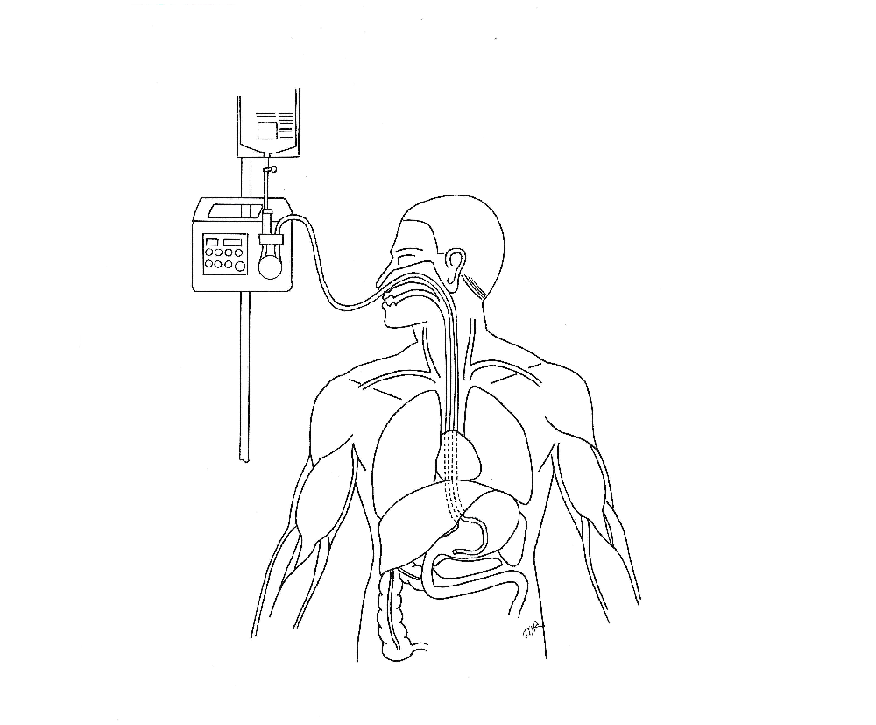
Nutritional and Non-nutritional Benefits of Early Enteral Nutrition
Reduce gut/lung axis of inflammation
Maintain MALT tissue
↑Production of secretory IgA at
epithelial surfaces
Attenuate oxidative stress
↓ Systemic Inflammatory
Response Syndrome (SIRS)
↑Dominance of anti-inflammatory Th2 over pro-inflammatory Th1 responses
Modulate adhesion molecules to ↓
transendothelial migration of macrophages and neutrophils
↑ Muscle function, mobility, return to baseline function
Provide micro & macronutrients, antioxidants
Maintain lean body mass
↓Muscle and tissue glycosylation
↑ Mitochondrial function
↑ Protein synthesis to meet metabolic demand
Maintain gut integrity
↓Gut permeability
Support commensal bacteria
Stimulate oral tolerance
↑Butyrate production
Promote insulin sensitivity,
↓hyperglycemia (AGEs)
↑ Absorptive capacity
Influence anti-inflammatory receptors
in GI tract
↓ Virulence of pathogenic organisms
↑ Motility, contractility

Slide 6
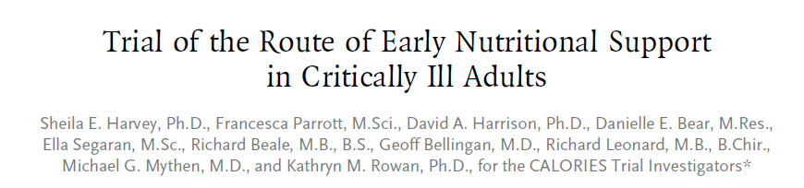
Pragmatic RCT in 33 ICUs in England
2400 patients expected to require nutrition support for at least 2 days after unplanned admission
Early EN vs Early PN
According to local products and policies
Powered to detect a 6.4% ARR in 30 day mortality
Harvey SE et al. N Engl J Med. 2014;371:1673-1684.

Slide 7
Caloric intake
Parenteral route
Enteral route
40
No difference in 30 day or 90 day mortality or infection nor 14 other secondary outcomes
Calories (kcal per kg)
30
20
10
0
Suboptimal method of determining infection
1
2
3
4
5
6
Days from Initiation of Early Nutritional Support
Protein Delivered: EN 0.7 gm/kg; PN 1.0 gm/kg
Adapted from Harvey SE, et al. N Engl J Med. 2014;371:1673-1684.
Notes:
Relied on micro data plus antibiotics, no adjudication or explication how the presence or absence of infection was determined. Reported as number of infections per patient.

Slide 8
CALORIES Trial: Results of Subgroup Analysis on 30-day Mortality
Harvey SE, et al. N Engl J Med. 2014;371:1673-1684.

Slide 9
Early EN (within 24-48 hrs of admission) is recommended!
Optimal Amount of Protein and Calories for Critically Ill Patients?

Slide 10
Increasing Calorie Debt Associated With Worse Outcomes
Caloric Debt
Adequacy of EN
↑ Caloric debt associated with:
  ↑ Longer ICU stay
  ↑ Days on mechanical ventilation
  ↑ Complications
  ↑ Mortality
Rubinson CCM 2004; Villet Clin Nutr. 2005; Dvir Clin Nutr. 2006; Petros Clin Nutr. 2006

Slide 11
Near-target Caloric Intake in Critically Ill Medical –surgical Patients is Associated With Adverse Outcomes
60
ICU Mortality
Hospital mortality
Infection
VAP
50
40
% Patients
30
20
10
0
0-10
10.1-20
20.1-30
30.1-40
40.1-50
50.14-60
60.1-70
70.1-80
80.1-90
>90
% Caloric Intake/Target
Arabi YM et al. JPEN J Parenter Enteral Nutr. 2010;34(3):280-8.

Slide 12
Optimal Amount of Calories for
Critically Ill Patients:
Depends on how you slice the cake!
Objective: To examine the relationship between the amount of calories received and mortality using various sample restriction and statistical adjustment techniques and demonstrate the influence of the analytic approach on the results.
Design: Prospective, multi-institutional audit
Setting: 352 Intensive Care Units (ICUs) from 33 countries.
Patients: 7,872 mechanically ventilated, critically ill patients who remained in ICU for at least 96 hours.
Heyland Crit Care Med 2011

Slide 13
Association Between 12-day Average Caloric Adequacy and
60-day Hospital Mortality
(Comparing patients rec’d >2/3 to those who rec’d <1/3)
A. In ICU for at least 96 hours. Days after permanent progression to exclusive oral feeding are included as zero calories*
B. In ICU for at least 96 hours. Days after permanent progression to exclusive oral feeding are excluded from average adequacy calculation.*
C. In ICU for at least 4 days before permanent progression to exclusive oral feeding. Days after permanent progression to exclusive oral feeding are excluded from average adequacy calculation.*
Unadjusted
Adjusted
D. In ICU at least 12 days prior to permanent progression to exclusive oral feeding*
0.4
0.6
0.8
1.0
1.2
1.4
1.6
Odds ratios with 95% confidence intervals
*Adjusted for evaluable days and covariates, covariates include region (Canada, Australia and New Zealand, USA, Europe and South Africa, Latin America, Asia), admission category (medical, surgical), APACHE II score, age, gender and BMI.
Notes:
Remove the 1/3-2/3 data

Slide 14
Association Between 12-day Nutritional Adequacy and 60-Day Hospital Mortality
0.50
0.45
Probability of Patient Death
0.40
0.35
Optimal amount=
80-85%
0.30
0.25
0.20
0
10
20
30
40
50
60
70
80
90
100
110
120
Percent of Caloric Prescription Received in First 12 ICU Days
Heyland DK et al. Crit Care Med. 2011;39(12):2619-26.

Slide 15
Impact of Protein Intake on 60-day Mortality
Data from 2828 patients from 2013 International Nutrition Survey
 | Patients in ICU ≥ 4 d
Variable | 60-Day Mortality, Odds Ratio (95% CI)
 |  | Adjusted¹ | Adjusted²
Protein Intake (Delivery > 80% of prescribed vs. < 80%) |  | 0.61 (0.47, 0.818) | 0.66 (0.50, 0.88)
Energy Intake (Delivery > 80% vs. < 80% of Prescribed) |  | 0.71 (0.56, 0.89) | 0.88 (0.70, 1.11)
¹ Adjusted for BMI, Gender, Admission Type, Age, Evaluable Days, APACHE II Score, SOFA Score
² Adjusted for all in model 1 plus for calories and protein
Nicolo, Heyland (Submitted))

Slide 16
The Validation of the NUTrition Risk in the Critically Ill Score (NUTRIC Score)
Interaction between NUTRIC Score and nutritional adequacy (n=211)*
1.0
9
9
P value for the interaction=0.01
0.8
9
8
9
9
8
8
0.6
7
8
9
8
8
8
7
8
9
10
7
7
8
8
10
8
7
8
28 Day Mortality
7
7
8
8
8
7
8
8
7
7
7
8
3
0.4
7
7
7
7
8
8
6
7
7
7
8
6
7
7
7
6
6
6
7
7
9
6
6
6
7
6
6
6
6
6
6
6
6
6
6
6
6
6
6
6
6
3
6
6
6
6
6
6
6
6
6
6
6
6
6
6
5
6
5
7
5
5
5
5
5
5
5
5
5
5
5
5
5
5
5
5
5
0.2
5
5
5
5
5
5
5
5
5
5
5
5
5
5
5
4
3
5
5
5
5
5
5
5
5
5
4
4
4
4
4
4
4
4
4
4
2
4
4
4
4
3
4
4
4
4
4
3
4
4
4
4
4
8
4
4
3
9
4
4
4
4
4
3
3
3
2
1
4
3
2
4
4
3
3
3
3
2
2
3
2
2
1
1
3
3
1
0.0
2
3
2
1
1
1
1
1
0
50
100
150
Nutrition Adequacy Levels (%)
Heyland Critical Care 2011, 15:R28

Slide 17

Earlier and Optimal Nutrition (>80%) is Better!
(For High Risk Patients)
If you feed them (better!)
They will leave (sooner!)

Slide 18

Health Care-associated Malnutrition
What if you can’t provide adequate nutrition enterally?
… to add PN or not to add PN,
that is the question!

Slide 19
Early vs. Late Parenteral Nutrition in Critically ill Adults
4620 critically ill patients
Randomized to early PN
  Rec’d 20% glucose 20 ml/hr then PN on day 3
OR late PN
  D5W IV then PN on day 8
All patients standard EN plus ‘tight’ glycemic control
Results:
Late PN associated with:
  6.3% likelihood of early discharge alive from ICU and hospital
  Shorter ICU length of stay (3 vs 4 days)
  Fewer infections (22.8 vs 26.2 %)
  No mortality difference
Casaer MP, et al.

Slide 20
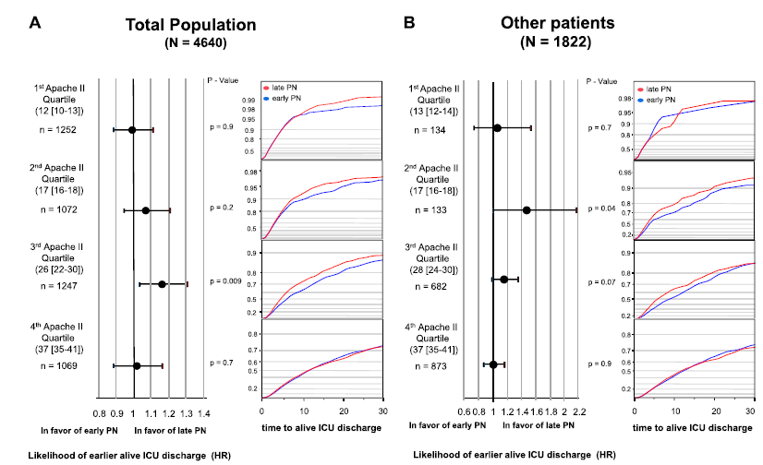
Early Nutrition in the ICU: Less is more!
Post-hoc analysis of EPANIC
Treatment effect persisted in all subgroups
Casaer Am J Respir Crit Care Med 2013;187:247–255

Slide 21
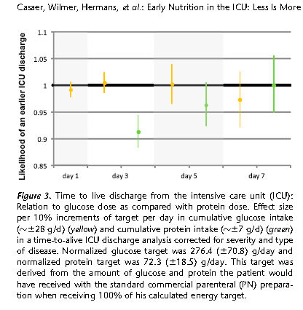
Early Nutrition in the ICU: Less is more!
Post-hoc analysis of EPANIC
Indication bias:
1) patients with longer projected stay would have been fed more aggressively; hence more protein/calories is associated with longer lengths of stay. (remember this is an unblinded study).
2) 90% of these patients are elective surgery. there would have been little effort to feed them and they would have categorically different outcomes than the longer stay patients in which their were efforts to feed
Protein is the bad guy!!
Casaer Am J Respir Crit Care Med 2013;187:247–255

Slide 22
Early vs. Late Parenteral Nutrition in Critically Ill Adults
Variable | Late-initiation Group (N=2328) | Early-initiation Group (N=2321) | P Value
Safety Outcome
Vital status-no. (%)
Discharged live from ICU within 8 days | 1750 (75.2) | 1658 (71.7) | 0.007
Mechanical ventilation
Median duration (interquartile range)-days | 2 (1-5) | 2 (1-5) | 0.02
Duration >2 days-no. (%) | 846 (36.3) | 930 (40.2) | 0.006
Hazard ratio (96% CI) for time to definitive weaning from ventilation | 1.06 (0.99-1.12) |  | 0.07
Duration of stay in ICU
Median (interquartile range)-days | 3 (2-7) | 4 (2-9) | 0.02
Duration >3 days-no. (%) | 1117 (48.0) | 1185 (51.3) | 0.02
Hazard ratio (95% CI) for time to discharge alive from ICU | 1.06 (1.00-1.13) |  | 0.04
Casaer MP, et al. N Engl J Med. 2011;365:506-17.

Slide 23
Early vs. Late Parenteral Nutrition in Critically ill Adults
? Applicability of data
  No one give so much IV glucose in first few days
  No one practice tight glycemic control
Right patient population?
  Majority (90%) surgical patients (mostly cardiac-60%)
  Short stay in ICU (3-4 days)
  Low mortality (8% ICU, 11% hospital)
  >70% normal to slightly overweight
Not an indictment of PN
  Clear separation of groups after 2-3 days
  Early group only rec’d PN on day 3 for 1-2 days on average
  Late group –only ¼ rec’d any PN
Casaer MP, et al. N Engl J Med. 2011;365:506-17.

Slide 24
Optimisation of Energy Provision With Supplemental Parenteral Nutrition in Critically Ill Patients: A Randomised Controlled Trial
SPN + EN
100
EN
80
Energy Provision (%)
60
40
EN
Inclusion and randomisation
20
Intervention period
Follow-up
0
1
2
3
4
5
6
7
8
9
28
ICU admission
Indirect calorimetry
Days since ICU admission
Adapted from Heidegger CP, et al. Lancet. 2013;381(9864):385-93.

Slide 25
Energy Provision With Supplemental Parenteral Nutrition in Critically Ill Patients
1.0
SPN
Proportion Without Nosocomial Infection
EN
0.9
0.8
P=0.038
0.7
0.6
0.5
0
9
28
Days Since Admission to ICU
Number at Risk
SPN | 153 | 148 | 99
EN | 152 | 147 | 71
 | Intervention Period (days 4-8) |  | Follow-up (days 9-28)
 | SPN | EN | SPN | EN
Pneumonia | 35 (67%) | 28 (65%) | 22 (46%) | 32 (45%)
Blood stream infection | 10 (19%) | 6 (14%) | 9 (19%) | 13 (18%)
Urogenital infection | 4 (8%) | 2 (5%) | 7 (15%) | 5 (7%)
Abdominal infection | 1 (2%) | 4 (9%) | 8 (17%) | 8 (11%)
Other infection | 2 (4%) | 3 (7%) | 2 (4%) | 13 (18%)
Adapted from Heidegger CP, et al. Lancet. 2013;381(9864):385-93.

Slide 26

Adult patients were eligible for enrollment within 24 hours of ICU admission if they were expected to remain in the ICU on the calendar day after enrollment, were considered ineligible for enteral nutrition by the attending clinician due to a short-term relative contraindication and were not expected to PN or oral nutrition
Doig GS, et al. JAMA. 2013;309(20):2130-8.

Slide 27
Baseline Characteristics | Standard Care (n=682) |  | Early PN (n=681)
Age, mean (SD), y | 68.6 (14.3) |  | 68.4 (15.1)
Female gender, No. (%) | 262 (38.4) |  | 281 (41.3)
BMI, mean (SD) | 28.5 (6.9) |  | 27.9 (6.8)
BMI ≥30, No. (%) | 224 (32.8) |  | 190 (27.9)
BMI <18.5, No. (%) | 20 (2.9) |  | 26 (3.8)
APACHE II score, mean (SD) | 21.5 (7.8) |  | 20.5 (7.4)
Mechanically ventilated, No. (%)
Source of admission to ICU, No. (%)
Operating room | 430 (63.0) | 464 (68.1)
Other hospital | 91 (13.3) | 70 (10.3)
Emergency department | 88 (12.9) | 70 (10.3)
Hospital ward | 71 (10.4) | 72 (10.6)
Transfer from ICU | 2 (0.3) | 5 (0.7)
ICU readmission | 0 | 0
Surgical admission, No. (%)
Emergency surgery | 305 (44.7) | 320 (47.0)
Elective surgery | 125 (18.3) | 144 (21.5)
APACHE III admission diagnosis
Gastrointestinal | 412 (60.4) | 409 (60.0)
Cardiovascular | 126 (18.5) | 145 (21.3)
Sepsis | 54 (7.9) | 43 (6.3)
Respiratory | 48 (7.0) | 30 (4.4)
Trauma | 19 (2.8) | 21 (3.1)
Neurological | 9 (1.3) | 8 (1.1)
Renal | 4 (0.6) | 5 (0.7)
Metabolic | 3 (0.4) | 4 (0.6)
Hematological | 0 | 2 (0.3)
Gynecological | 0 | 2 (0.3)
Orthopedic surgery | 0 | 1 (0.1)
Other | 7 (1.0) | 11 (1.6)
Who were these patients?
Overall, standard care group remained unfed for 2.8 days after randomization
40% of standard care group never rec’d any artificial nutrition; remained in ICU 3.5 days
Doig GS, et al. JAMA. 2013;309(20):2130-8.

Slide 28
 | Standard Care (n=680) | Early PN (n=678) | Risk Differences, % (95% CI) | Odds Ratio (95%CI) | P Value
Deaths before study day, No (%) | 155 (22.8) | 146 (21.5) | -1.26 (-6.6 to 4.1) | 0.93 (0.71 to 1.21) | 0.60
Quality of life and physical function, mean (SD) | (n=625) | (n=532) | Difference (95% CI)
RAND-36 general health status | 45.5 (26.8) (n=516) | 49.8 (27.6) (n=525) | 4.3 (0.95 to 7.58) |  | 0.01
ECOG performance status | 1.53 (1.1) (n=516) | 1.51 (1.1) (n=525) | -0.02 (-0.15 to 0.11) |  | 0.70
RAND-36 physical function | 40.7 (29.6) (n=513) | 42.5 (30.8) (n=524) | 1.8 (-1.85 to 5.52) |  | 0.33
Discharge status and length of stay | (n=682) | (n=681) | Difference (95% CI)
ICU stay, mean (95% CI), d | 9.3 (8.9 to 9.7) | 8.6 (8.2 to 9.0) | -0.75 (-1.47 to 0.04) |  | 0.06
Deaths before ICU discharge, No. (%) | 100 (14.66) | 81 (11.89) | -2.77% (-8.08% to 2.52%) |  | 0.15
Hospital stay, mean (95% CI), d | 24.7 (23.7 to 25.8) | 25.4 (24.4 to 26.6) | 0.7 (-1.4 to 3.1) |  | 0.50
Deaths before hospital discharge, No. (%) | 151 (22.1) | 140 (20.6) | -1.58% (-6.91% to 3.69%) |  | 0.51
Main inference: No harm by early PN (in contrast to EPaNIC)
Doig GS, et al. JAMA. 2013;309(20):2130-8.

Slide 29
What if you can’t provide adequate nutrition enterally?
… to TPN or not to TPN,
that is the question!
Case by case decision
Maximize EN delivery prior to initiating PN
Use early in high risk cases

Slide 30
Start PEP UP* within 24-48 hrs
YES
At 72 hrs
>80% of Goal Calories?
NO
Yes
No
High Risk?
Carry on!
Yes
No
Maximize EN with motility agents and small bowel feeding
No problem
YES
NO
Tolerating EN at 96 hrs?
* If EN not possible, go right to PN
Yes
No
Supplemental PN?
No problem

Slide 31
Parenteral Lipid Formulations

Slide 32
Soybean oil provides energy, essential fatty acids,
and fatty acids for building blocks, BUT……
Excessive supply of ω-6 PUFA
Increased 18:2ω-6 and 20:4ω-6 in cell membranes
Altered membrane
structure
Increased eicosanoid
production
Increased inflammation
Decreased cell-mediated immunity

Slide 33
If you are going to use PN, which lipid emulsion?
Soybean Oil (ω-6)
MCT
PN without Lipids
Olive Oil (ω-9)
Fish Oils (ω-3)
More
Pro-Inflammatory
Less
Pro-Inflammatory
Vanek VW, et al. Nutr Clin Pract. 2012;27(2):150-192.

Slide 34
Lipid-free PN?
There are no new randomized controlled trials since the 2009 update and hence there are no changes to the recommendation.
Recommendation:
Based on 2 level 2 studies, in critically ill patients who are not malnourished, are tolerating some EN, or when parenteral nutrition is indicated for short term use (< 10 days), withholding lipids high in soybean oil should be considered
There are insufficient data to make a recommendation about withholding lipids high in soybean oil in critically ill patients who are malnourished or those requiring PN for long term (> 10 days)
Practitioners will have to weigh the safety and benefits of withholding lipids high in soybean oil on an individual case-by-case basis in these latter patient populations

Slide 35
Lipid Emulsions: Classification
High LCT ω-6 | MCT/LCT 50:50 | High MUFA Ω-9 | High PUFA Ω-3 | Mixtures
Soybean Oil (SO) | SO + Coconut | Olive Oil (OO) + SO | Fish Oil (FO) | SO, FO, Coconut, OO
Intralipid® | Lipofundin® (MCT/LCT)® | ClinOleic® | Omegaven® | SMOF® Lipoplus®
ALTERNATIVE LIPID EMULSIONS

Slide 36
What Does the Evidence Show
About Alternative Lipid Emulsions
in the Critically Ill?

Slide 37

Study Selection Criteria
Study design
Randomized clinical, parallel group, controlled trials (RCT)
Population
Critically ill adult patients (>18 years old)
Intervention Parenteral strategies to reduce soybean-oil vs. Ω-6 oil-based LE (LCT)
Pre-specified Outcomes
Mortality, ICU and Hospital LOS, Infections

Slide 38
Overall Effect on Mortality of ω-6 Reducing Strategy (n=17 RCT)
Omega-6 Reducing
LCT or LCT+MCT
Risk Ratio
Risk Ratio
Study or Subgroup
Events
Total
Events
Total
Weight
M-H, Random, 95% CI
Year
M-H, Random, 95% CI
1.1.1 LCT + MCT vs LCT
Nijveldt
2
12
1
8
0.9%
1.33 [0.14, 12.37]
1998
Lindgren
1
15
0
15
0.4%
3.00 [0.13, 68.26]
2001
Garnacho-Montero
8
35
11
37
6.9%
0.77 [0.35, 1.69]
2002
Iovinelli
2
12
3
12
1.7%
0.67 [0.13, 3.30]
2007
Subtotal (95% CI)
74
72
9.9%
0.84 [0.43, 1.61]
Total events
13
15
Heterogeneity: Tau² = 0.00; Chi² = 0.94, df = 3 (P = 0.82); I² = 0%
Test for overall effect: Z = 0.53 (P = 0.59)
1.1.2 Fish oil containing emulsions vs LCT or LCT + MCT
Grecu
2
28
3
26
1.5%
0.62 [0.11, 3.41]
2003
Friesecke
18
83
22
82
14.4%
0.81 [0.47, 1.39]
2008
Wang 2009
0
28
2
28
0.5%
0.20 [0.01, 3.99]
2009
Barbosa
4
13
4
10
3.4%
0.77 [0.25, 2.34]
2010
Gupta
7
31
13
30
7.2%
0.52 [0.24, 1.13]
2011
Gultekin
8
16
7
16
7.7%
1.14 [0.54, 2.40]
2014
Grau-Carmona
26
81
16
78
14.6%
1.56 [0.91, 2.68]
2014
Burkhart
13
25
13
25
15.0%
1.00 [0.59, 1.70]
2014
Hall
4
30
9
30
3.8%
0.44 [0.15, 1.29]
2014
Subtotal (95% CI)
335
325
68.1%
0.90 [0.67, 1.20]
Total events
82
89
Heterogeneity: Tau² = 0.03; Chi² = 9.62, df = 8 (P = 0.29); I² = 17%
Test for overall effect: Z = 0.74 (P = 0.46)
1.1.3 Olive oil containing emulsions vs LCT or LCT + MCT
Huschak
4
18
1
15
1.0%
3.33 [0.42, 26.72]
2005
Garcia de Lorenzo
4
11
4
11
3.5%
1.00 [0.33, 3.02]
2005
Pontes-Arruda
19
103
21
101
13.7%
0.89 [0.51, 1.55]
2012
Umpierrez
5
51
8
49
3.9%
0.60 [0.21, 1.71]
2012
Subtotal (95% CI)
183
176
22.1%
0.90 [0.58, 1.39]
Total events
32
34
Heterogeneity: Tau² = 0.00; Chi² = 2.14, df = 3 (P = 0.54); I² = 0%
Ω-6 sparing-strategies were not associated with a reduction in mortality (RR= 0.91, 95% CI 0.74, 1.11, P=0.35, heterogeneity I² =0%)
Test for overall effect: Z = 0.49 (P = 0.62)
Total (95% CI)
592
573
100.0%
0.91 [0.74, 1.11]
Total events
127
138
Heterogeneity: Tau² = 0.00; Chi² = 12.72, df = 16 (P = 0.69); I² = 0%
0.01
0.1
1
10
100
Test for overall effect: Z = 0.93 (P = 0.35)
Favours omega-6 reducing
Favours LCT or LCT+MCT
Test for subgroup differences: Chi² = 0.04, df = 2 (P = 0.98), I² = 0%
Notes:
5 new RCTs. Note if Gupta, Burkhart and Hall are excluded RR=0.97, 95% CI 0.77-1.24, p=0.82, I^2=0.

Slide 39
Overall Effect on Ventilation Days
(n=7 RCT)
Omega-6 Reducing
LCT or LCT+MCT
Mean Difference
Mean Difference
Study or Subgroup
Mean
SD
Total
Mean
SD
Total
Weight
IV, Random, 95% CI
Year
IV, Random, 95% CI
1.4.1 Fish oil containing emulsions vs LCT or LCT + MCT
Grecu
2.83
1.62
8
5.23
2.8
7
48.7%
-2.40 [-4.76, -0.04]
2003
Friesecke
22.8
22.9
83
20.5
19
82
11.6%
2.30 [-4.12, 8.72]
2008
Barbosa
10
14.4
13
11
12.64
10
4.2%
-1.00 [-12.07, 10.07]
2010
Khor
13
10.1
9
11.6
9.5
5
4.6%
1.40 [-9.22, 12.02]
2011
Gupta
11.78
10.63
31
10.71
14.55
30
11.6%
1.07 [-5.34, 7.48]
2011
Subtotal (95% CI)
144
134
80.8%
-1.41 [-3.43, 0.61]
Heterogeneity: Tau² = 0.00; Chi² = 2.81, df = 4 (P = 0.59); I² = 0%
Test for overall effect: Z = 1.37 (P = 0.17)
1.4.2 Olive oil containing emulsions vs LCT or LCT + MCT
Garcia de Lorenzo
11
11.93
11
13
16.25
11
3.7%
-2.00 [-13.91, 9.91]
2005
Huschak
13
8.9
18
20.4
7
15
15.5%
-7.40 [-12.83, -1.97]
2005
Subtotal (95% CI)
29
26
19.2%
-6.47 [-11.41, -1.53]
Heterogeneity: Tau² = 0.00; Chi² = 0.65, df = 1 (P = 0.42); I² = 0%
Test for overall effect: Z = 2.57 (P = 0.01)
Total (95% CI)
173
160
100.0%
-1.98 [-4.31, 0.36]
Heterogeneity: Tau² = 1.46; Chi² = 6.92, df = 6 (P = 0.33); I² = 13%
-20
-10
0
10
20
Test for overall effect: Z = 1.66 (P = 0.10)
Favours omega-6 reducing
Favours LCT or LCT+MCT
Test for subgroup differences: Chi² = 3.46, df = 1 (P = 0.06), I² = 71.1%
Ω-6 sparing-strategies were associated with a trend towards a reduction in ventilation days
(WMD -1.98, 95% CI -4.31, 0.36, P=0.10)
Notes:
2 new RCTs. Note if Gupta and Khor are excluded RR=-2.57, 95% CI -5.51-0.37, p=0.09, I^2=25.

Slide 40
Overall Effect on ICU Length of Stay (n=11 RCT)
Omega-6 Reducing
LCT or LCT+MCT
Mean Difference
Mean Difference
Study or Subgroup
Mean
SD
Total
Mean
SD
Total
Weight
IV, Random, 95% CI
Year
IV, Random, 95% CI
1.3.1 LCT + MCT vs LCT
Nijveldt
13.8
2.9
12
17.4
3
8
14.0%
-3.60 [-6.25, -0.95]
1998
Garnacho-Montero
16.6
6.1
35
15.8
7
37
13.2%
0.80 [-2.23, 3.83]
2002
Subtotal (95% CI)
47
45
27.2%
-1.46 [-5.77, 2.85]
Heterogeneity: Tau² = 7.57; Chi² = 4.59, df = 1 (P = 0.03); I² = 78%
Test for overall effect: Z = 0.67 (P = 0.51)
1.3.2 Fish oil containing emulsions vs LCT or LCT + MCT
Grecu
3.32
1.48
8
9.28
3.08
7
14.3%
-5.96 [-8.46, -3.46]
2003
Friesecke
28
25
83
23
20
82
6.8%
5.00 [-1.90, 11.90]
2008
Barbosa
12
14.4
13
13
12.6
10
3.5%
-1.00 [-12.06, 10.06]
2010
Khor
10.3
8.4
14
8.4
6.5
13
8.5%
1.90 [-3.74, 7.54]
2011
Gupta
15.96
7.57
31
15.88
6.47
30
12.2%
0.08 [-3.45, 3.61]
2011
Hall
8.8
7.7
30
12.3
12.4
30
9.1%
-3.50 [-8.72, 1.72]
2014
Subtotal (95% CI)
179
172
54.4%
-1.09 [-4.72, 2.53]
Heterogeneity: Tau² = 12.70; Chi² = 16.42, df = 5 (P = 0.006); I² = 70%
Test for overall effect: Z = 0.59 (P = 0.55)
1.3.3 Olive oil containing emulsions vs LCT or LCT + MCT
Garcia de Lorenzo
32.9
10.6
11
41.8
16.3
11
3.3%
-8.90 [-20.39, 2.59]
2005
Huschak
17.9
11.2
18
25.1
7
15
7.6%
-7.20 [-13.47, -0.93]
2005
Umpierrez
17
18
51
15.2
14
49
7.5%
1.80 [-4.51, 8.11]
2012
Subtotal (95% CI)
80
75
18.4%
-4.08 [-10.97, 2.81]
Heterogeneity: Tau² = 21.46; Chi² = 4.90, df = 2 (P = 0.09); I² = 59%
Test for overall effect: Z = 1.16 (P = 0.25)
Total (95% CI)
306
292
100.0%
-1.80 [-4.10, 0.51]
Heterogeneity: Tau² = 8.08; Chi² = 26.81, df = 10 (P = 0.003); I² = 63%
-20
-10
0
10
20
Test for overall effect: Z = 1.52 (P = 0.13)
Favours omega-6 reducing
Favours LCT or LCT+MCT
Test for subgroup differences: Chi² = 0.58, df = 2 (P = 0.75), I² = 0%
Ω-6 reducing-strategies were associated with a trend towards a reduction in ICU LOS
(WMD -1.80, 95% CI -4.10, 0.51, P=0.13)
Notes:
3 new RCTs. Note if Hall, Gupta, Khor are excluded RR=-2.31, 95% CI -5.28-0.66, p=0.13, I^2=68.

Slide 41
Which Alternative Lipid Emulsion to Use?
No head-to-head trials (and not likely to be)
We analyzed our International Nutrition Survey database to evaluate effect of Alt Lipids on outcomes
Analyzed adjusted for key confounding variables
Edmunds CE, et al. Crit Care Med. 2014;42(5):1168-1177.
1

Slide 42
Which Alternative Lipid Emulsion to Use?
Total enrolled from INS 2007, 2008, 2009 and 2011
12,585 patients
12,134 patients (96.4%) excluded
10,591 (84.2%) patients received EN
1124 (8.9%) patients received neither PN nor EN
258 (2.1%) patients received PN for <5 days
34 (0.03%) patients received an unknown type of IVLE
127 (1.0%) patients changed type of IVLE during their PN course
Total Included
451 patients
Lipid free
70 patients
Soybean oil
223 patients
MCT oil
65 patients
Olive oil
74 patients
Fish oil
19 patients
Edmunds CE, et al. Crit Care Med. 2014;42(5):1168-1177.

Slide 43
Which Alternative Lipid Emulsion to Use?
5
Fish Oil
Cumulative Likelihood of Being Discharged from ICU
4
3
Olive Oil
Lipid Free
2
MCT
Soybean
1
0
0.0
10.0
20.0
30.0
40.0
50.0
60.0
Days from Admission to ICU
Adapted from Edmunds CE, et al. Crit Care Med. 2014;42(5):1168-1177.

Slide 44
Effect of a FO-containing LE on Plasma Phospholipids, FA,
Inflammatory Markers and Clinical Outcomes
N= 25 (SIRS/sepsis receiving PN) ,
Randomized to 50:50 MCT/soybean emulsion or LE with 50% MCT, 40% soy, and 10% FO x 5 days.
Dose of FO: rec’d 6.4 gms/d
and 0.09 g/kg/d
FO
Greater attenuation of IL-1B, IL-6, TNFα
Improved PaO2/FiO2 ratio by day 6
Tendency to reduce Hospital Stay (P= .08) and Deaths (P= NS)
Barbosa V, et al. Critical Care 2010;14:R5

Slide 45
Parenteral Fish Oil in ICU Patients with Sepsis:
A Pilot Study
RCT
Patients with sepsis / severe sepsis (n= 60)
Parenteral FO based LE vs. standard care
Primary outcome: ΔSOFA, and Maximum- SOFA
Secondary outcomes: 28-d mortality, ICU and hospital LOS, mean CRP, and days free or organ dysfunction/failure
Omegaven®
0.2 g FO/kg/d
0.05 g FO/kg/h until day 14 or ICU discharge
Δ-SOFA 2.2 ± 2.2 vs. 1.0 ± 1.5 P = .005
Max. SOFA 10.1 ± 4.2 vs. 8.1 ± 3.2, P = .041
Max. PCR
186.7 ± 78 vs. 141.5 ± 62.6, P = .019
Hall TC et al. JPEN J Parenter Enteral Nutr 2014 In press.

Slide 46
ICU Lipids Study
APACHE II >13, TPN ≥ 5 d, *EN in the first 3 d of ICU admission, requiring TPN (do not reach 75% of the energy requirements)
20% MCT/LCT/FO (50:40:10, Lipoplus®)
≈ 0.1 g FO/kg BW
Soybean oil LE
20% MCT/LCT (50:50, Lipofundina®)
Grau Carmona T, et al. Crit Care Med 2015.

Slide 47
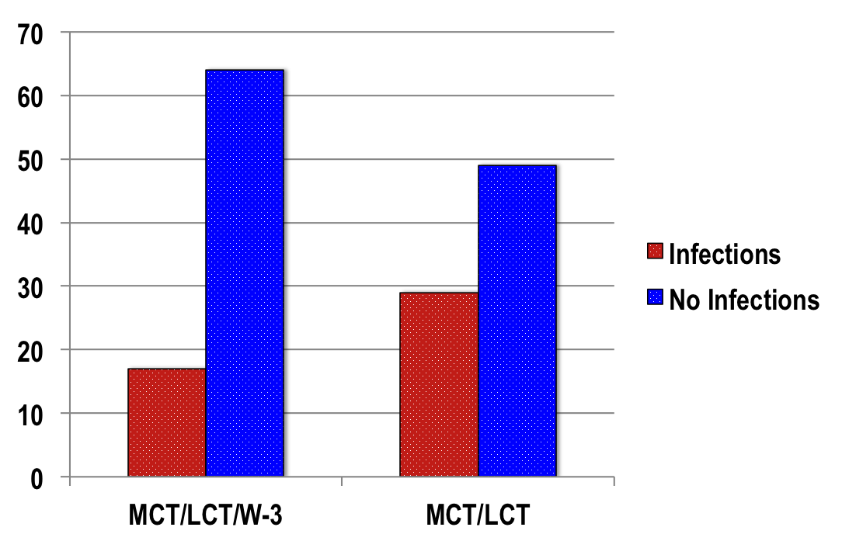
ICU Lipids: Nosocomial Infections (ITT)
64
49
Number of patients
29
17
RR: 1,77 IC 95% 1,06-2,95, P= .03
Grau Carmona T, et al. Crit Care Med 2015.

Slide 48
Overview of Clinical Outcomes (ITT)
 | MCT/LCT (n= 78) | MCT/LCT/ω-3 (n= 81) | P value
ICU LOS (days) | 18 [13.25] | 12 [18.5] | 0.369
Hospital LOS (days) | 36.5 [34.0] | 25 [34.5] | 0.059
Mechanical Ventilation (days) | 8 [8.5] | 7 [6.0] | 0.47
ICU mortality (n, %) | 16 (20.5) | 26 (32.5) | 0.106
Hospital mortality (n, %) | 6 (9.7) | 6 (11.1) | 1.000
6-month survival (Kaplan-Meyer, d) | 137.2 ± 7.6 | 117.7 ± 8.5 | 0.082
Grau Carmona T, et al. Crit Care Med 2015.

Slide 49
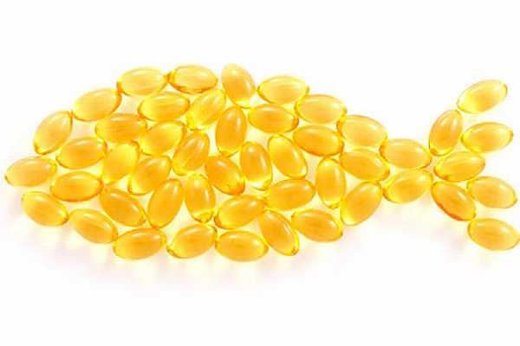
Updated Meta-analysis of IV Fish Oil
in the Critically Ill?

Slide 50
Fish Oil Lipid Emulsions in the Critically Ill
Mortality (n=9 RCT)
0.90 (0.67, 1.20)
P=0.46
FO-containing lipid emulsions were not associated with a trend towards a reduction in mortality
RR= 0.90, 95% CI 0.67-1.20, P= 0.46
Unpublished, Manzanares W, 2014
Notes:
4 new RCTs. Note if Hall, Gupta, Burkhart are excluded RR=1.05, 95% CI 0.77-1.45, p=0.75, I^2=0.

Slide 51
Fish Oil Lipid Emulsions in the Critically Ill
Infection (n=5 RCT)
Fish Oils
LCT or LCT+MCT
Risk Ratio
Risk Ratio
Study or Subgroup
Events
Total
Events
Total
Weight
M-H, Random, 95% CI
Year
M-H, Random, 95% CI
Grecu
0
8
1
7
1.5%
0.30 [0.01, 6.29]
2003
Friesecke
10
83
11
82
21.4%
0.90 [0.40, 2.00]
2008
Wang 2009
6
28
9
28
17.3%
0.67 [0.27, 1.62]
2009
Grau-Carmona
17
81
29
78
52.3%
0.56 [0.34, 0.94]
2014
Hall
3
30
5
30
7.6%
0.60 [0.16, 2.29]
2014
Total (95% CI)
230
225
100.0%
0.64 [0.44, 0.92]
Total events
36
55
Heterogeneity: Tau² = 0.00; Chi² = 1.18, df = 4 (P = 0.88); I² = 0%
0.1
0.2
0.5
1
2
5
10
Test for overall effect: Z = 2.38 (P = 0.02)
Favour Fish Oils
Favours LCT or LCT+MCT
FO-containing lipid emulsions were associated with a significant reduction in mortality
RR= 0.64, 95% CI 0.44-0.92, P= 0.02
Unpublished, Manzanares W, 2014
Notes:
4 new RCTs. Note if Hall, Gupta, Burkhart are excluded RR=1.05, 95% CI 0.77-1.45, p=0.75, I^2=0.

Slide 52
Fish Oil Lipid Emulsions in the Critically Ill
Ventilation Days (n=5 RCT)
Fish Oils
Non Fish Oils
Mean Difference
Mean Difference
Study or Subgroup
Mean
SD
Total
Mean
SD
Total
Weight
IV, Random, 95% CI
Year
IV, Random, 95% CI
Grecu
2.83
1.62
8
5.23
2.8
7
73.3%
-2.40 [-4.76, -0.04]
2003
Friesecke
22.8
22.9
83
20.5
19
82
9.9%
2.30 [-4.12, 8.72]
2008
Barbosa
10
14.4
13
11
12.64
10
3.3%
-1.00 [-12.07, 10.07]
2010
Gupta
11.78
10.63
31
10.71
14.55
30
9.9%
1.07 [-5.34, 7.48]
2011
Khor
13
10.1
9
11.6
9.5
5
3.6%
1.40 [-9.22, 12.02]
2011
Total (95% CI)
144
134
100.0%
-1.41 (-3.43,0.61)
-1.41 [-3.43, 0.61]
Heterogeneity: Tau² = 0.00; Chi² = 2.81, df = 4 (P = 0.59); I² = 0%
-10
-5
0
5
10
P= 0.17
Test for overall effect: Z = 1.37 (P = 0.17)
Favour Fish Oils
Favours Non Fish Oil
FO-containing emulsions showed a trend towards reduction in the duration of MV days
WMD -1.41, 95% CI -3.43, 0.61, P=0.17
Unpublished, Manzanares W, 2014
Notes:
No Change. Note if Khor, Gupta are excluded RR=-1.81, 95% CI -3.98-0.36, p=0.10, I^2=0.

Slide 53
PN Type of Lipids
2009 Recommendation
There are insufficient data to make a recommendation on the type of lipids to be used in critically ill patients receiving parenteral nutrition.
2013 Recommendation
IV lipids that reduce the load of omega-6 fatty acids/soybean oil emulsions should be considered. There are insufficient data on type of soybean reducing lipids.

Slide 54
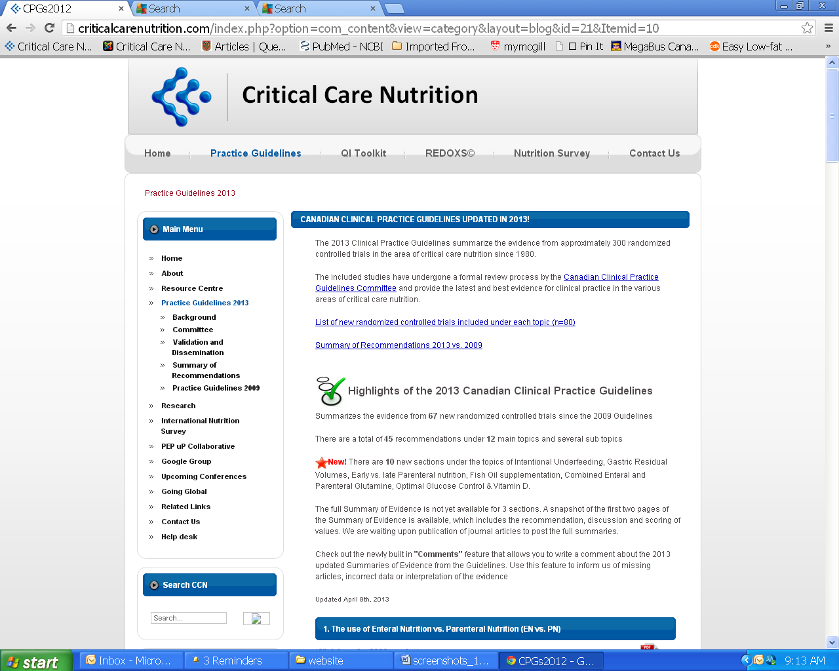

Slide 55
Questions?

